Slide 1

HEAT EXCHANGER
SUBMITTED TO: Er. Akash Rana(HOD)
Department of Petroleum
SUBMITTED BY: Inzamam Ul Haque
Mirza Abdul Raheman
Mohd. Shahzar
Chisti Tahir Husen
(IIIrd Year)

Slide 2
Heat exchanger
A heat exchanger is a piece of equipment built for efficient heat transfer from one medium to another medium. It is widely use in
space heating,
power plants,
chemical plants,
petrochemical plants,
petroleum refineries,
natural gas processing.

Slide 3
Types of heat exchangers
Double pipe heat exchanger
Shell and tube heat exchanger
Plate and shell heat exchanger
Pillow plate heat exchanger
Fluid heat exchangers
Waste Heat Recovery Units
Dynamic scraped surface heat exchanger

Slide 4
Double pipe heat exchanger
Double pipe heat exchangers are the simplest exchangers used in industries.
On one hand, these heat exchangers are cheap for both design and maintenance, making them a good choice for small industries.

Slide 5
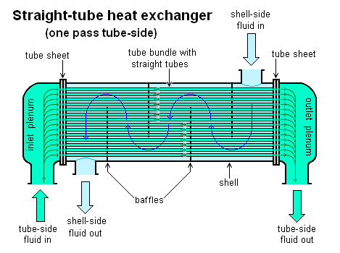
Shell and tube heat exchanger

Slide 6
Shell and tube heat exchanger
Shell and tube heat exchangers consist of a series of tubes. One set of these tubes contains the fluid that must be either heated or cooled.
The second fluid runs over the tubes that are being heated or cooled so that it can either provide the heat or absorb the heat required. A set of tubes is called the tube bundle and can be made up of several types of tubes: plain, longitudinally finned.

Slide 7
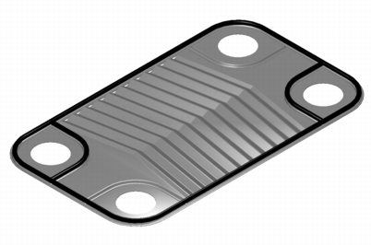
Plate and shell heat exchanger

Slide 8
Plate and shell heat exchanger
A third type of heat exchanger is a plate and shell heat exchanger, which combines plate heat exchanger with shell and tube heat exchanger technologies.
The heart of the heat exchanger contains a fully welded circular plate pack made by pressing and cutting round plates and welding them together.

Slide 9
Pillow plate heat exchanger
A pillow plate exchanger is commonly used in the dairy industry for cooling milk in large direct-expansion stainless steel bulk tanks. The pillow plate allows for cooling across nearly the entire surface area of the tank, without gaps that would occur between pipes welded to the exterior of the tank.

Slide 10
Fluid heat exchangers
This is a heat exchanger with a gas passing upwards through a shower of fluid (often water), and the fluid is then taken elsewhere before being cooled. This is commonly used for cooling gases whilst also removing certain impurities, thus solving two problems at once.

Slide 11
Waste Heat Recovery Units
A Waste Heat Recovery Unit (WHRU) is a heat exchanger that recovers heat from a hot gas stream while transferring it to a working medium, typically water or oils. The hot gas stream can be the exhaust gas from a gas turbine or a diesel engine or a waste gas from industry or refinery.

Slide 12
Dynamic scraped surface heat exchanger
Another type of heat exchanger is called "(dynamic) scraped surface heat exchanger". This is mainly used for heating or cooling with high-viscosity products, crystallization processes, evaporation and high-fouling applications.

Slide 13
THANK YOU

