Slide 1

A PRESENTATION ON
DRILL BITS
Submitted To:
Er. Akash Rana(HOD)
Petroleum Deptt.
Submitted by:
Patel Dhrupad
PathanVasheel
Patel Harsh
Vasani Hitesh
Rahul Kumar
( IIIrd Year)

Slide 2
INTRODUCTION
Drilling is a process to make a well bore in ground to reach a typical targeted depth where we can extract crude oil , natural gas and petroleum.
A Drill bit is set at end of drill string that breaks apart, cuts or crushes, rock structure when drilling a well bore.
The drill bits are hollow and allows expulsion of drilling fluid at high velocity and high pressure helps to clean the bit and take apart the drilled cuttings.

Slide 3
HISTORY
The first successful rolling cutter rock bit was introduced into the oil field by Howard Hughes Sr. in 1909.
This was a two-cone bit with cones that did not mesh, The bit was redesigned with meshing teeth (self-cleaning) in the 1920s and in the early 1930’s, the Tri-cone bit.
The tri-cone bits was working on Intrusion, where teeth are forced into the rock by the weight-on-bit, and pulled through the rock by the rotary action.
In starting era it was made from hardened steel then Tungsten Carbide used instead.
In 1976,PDC bits came in oil and gas exploration.

Slide 4
BASIC CONSIDERATIONS
JOURNAL ANGLE:-
The angle at which the journal is mounted, relative to a horizontal plane, also controls the cutter profile or pattern it drills, and it affects the amount of cutter action on the bottom of the hole.
Soft Formations:-Journal angle (33°) - this allows a cutter profile which accentuates cutter action and permits greater tooth depth.
Medium Formations:-Journal angle (34° to 36°), to decrease cutter action.
Hard Formations:-Uses a large journal angle (39°), to minimize cutter action

Slide 5
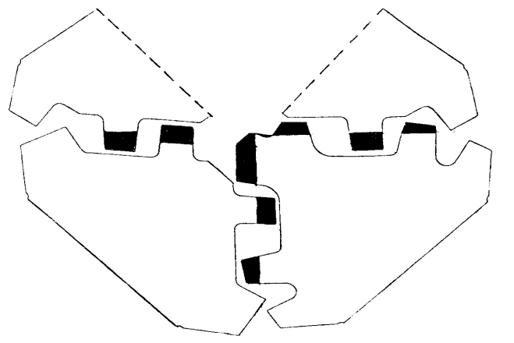
BASIC CONSIDERATIONS
INTERFITTING TEETH:-The idea of inter-fitting teeth , makes it possible to have large bit parts, and allows the inner row of teeth to cut new formation on each rotation. Inter-fitting also offers some degree of self-cleaning. One result of this inter-fitting is that each of the three cones are different.

Slide 6
BASIC CONSIDRATIONS
CIRCULATION SYSTEMS:-
Allows circulation or passage of the drilling fluid from drill bit.
Regular Circulation Bits:-Drilling fluid passes through the bore of the bit-drilled holes-cutters-bottom of the hole, to flush away the drill cuttings.
Jet Circulation Bits:-Manufactured with smooth, streamlined, fluid passageways in the dome of the bit. Drilling fluid passes through the bore-jet nozzles-hole bottom to flush cuttings away from the bit and up the hole.

Slide 7
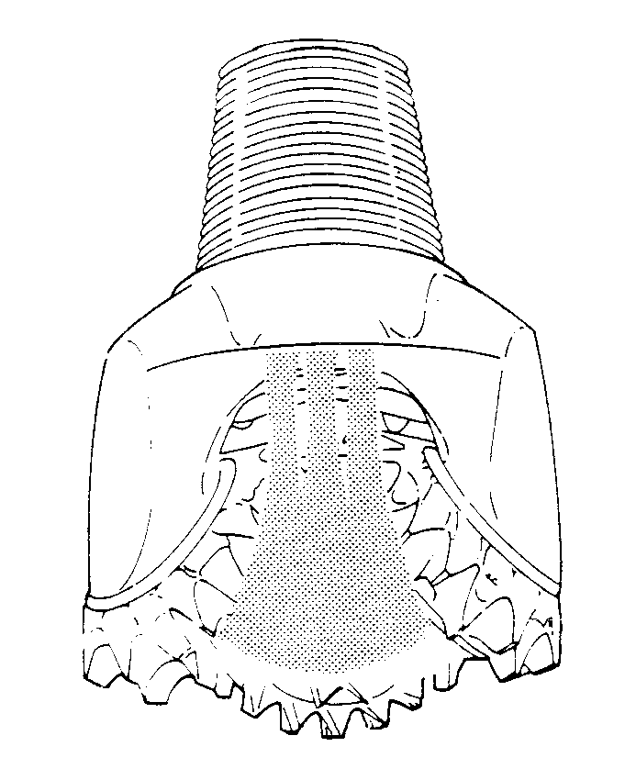
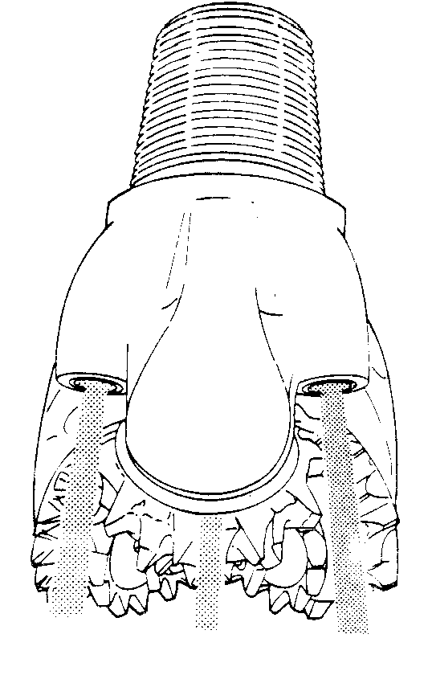

Slide 8
BASIC CONSIDERATIONS
CUTING STRUCTURES
Steel Tooth Cutting Structures:-
There are three basic design features incorporated in steel tooth cutting structures, teeth spacing, tooth hardfacing, and tooth angle.
Soft Formation Cutting Structures:-Teeth on this type of bit are few in number, widely spaced, and placed in a few broad rows. Having small tooth angles (39° to 42°). They are dressed with hard metal.
Medium Formation Cutting Structures:-Teeth on medium formation bits are fairly numerous, with moderate spacing and depth. The teeth are strong, and are a compromise between hard and soft bits, with tooth angles of 43° to 46°.
Hard Formation Cutting Structures:-There are many teeth on this type of bit. They are closely spaced and are short and blunt. There are many narrow rows with tooth angles of 46° to 50 °.

Slide 9
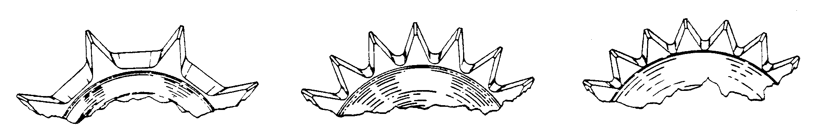
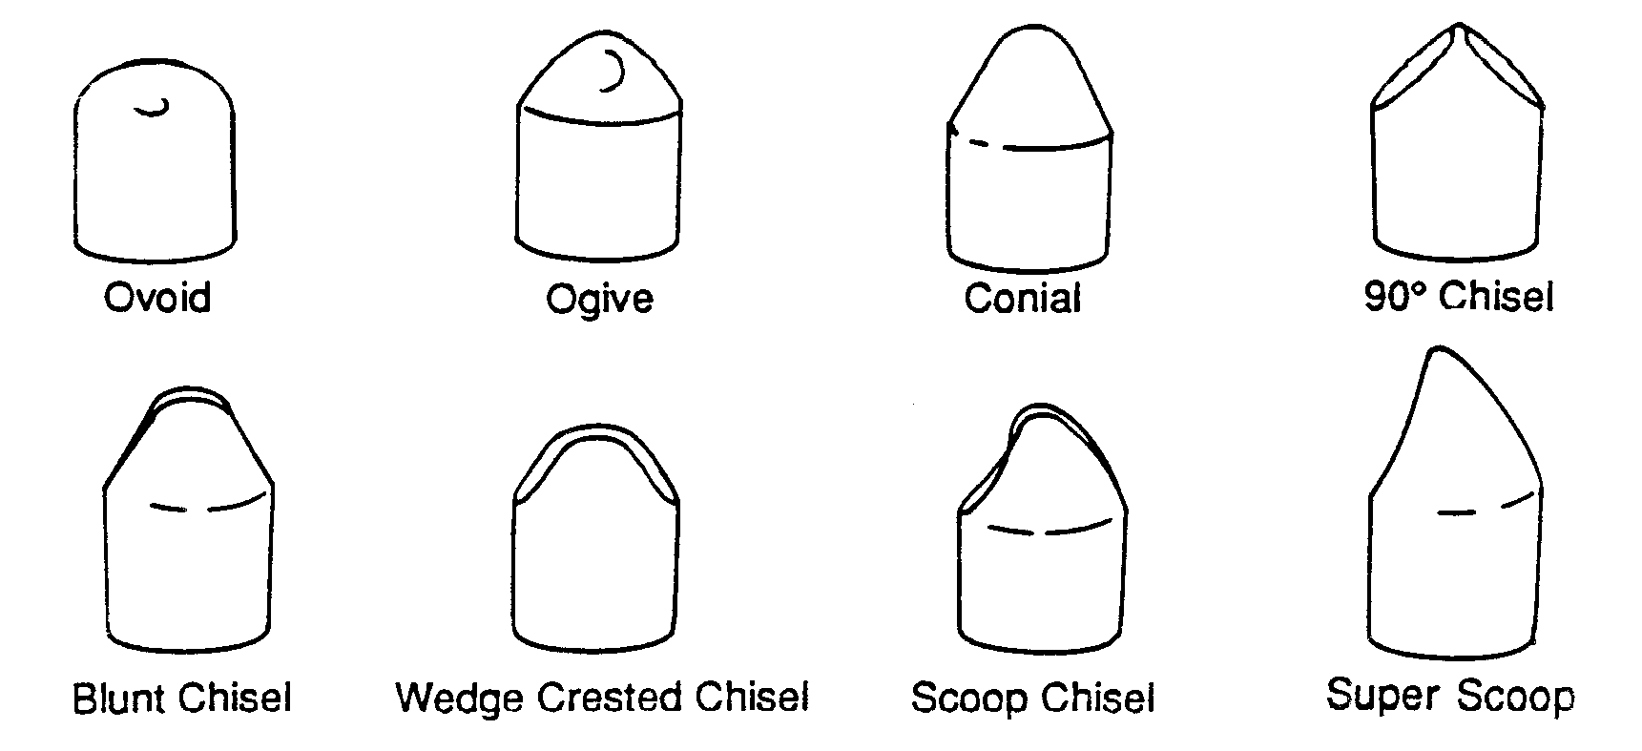

Slide 10
Tungsten Carbide Cutting Structures:-Since most of the basic design features of the mill tooth cuttings structures have been incorporated into insert bits, the main variations occur in insert shape.
Drag based structures:-
Working on dragging base, simply scratches the rocks to be drilled under torque gained from drill collards and Weight On Bit.

Slide 11
CLASSIFICATION
STEEL BASED:-
In starting time the drilling bits were made from steel and cast iron.
In early 1910’s,The rolling cutter bits working on Intrusion was made by light cast iron core surrounded by Carbon mixed steel having higher strength.
It was likely useful in soft and medium rocks but for hard rock formation it was likely to digested in ground.

Slide 12
DIAMOND BITS:-
In 1920’s Diamond bits were introduced in oil industry for drilling hard formations, but it costs 20 times than the roller cutting bits.
This Bits were made by layering the diamond matrix in high carbon iron, but from 1940’s Tungsten Carbide powder replaced use of iron.
In early days it was under less interest but after 1960 it was widely adopted for drilling hard formations.

Slide 13
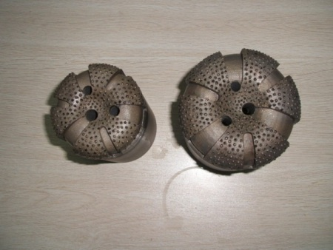
Figure(Diamond Bit)

Slide 14
TCI(Tungsten Carbide Inserts):-
Tungsten Carbide layered rolling cutter bits was firstly introduced in 1923.
In reason, Less in price and more stable than steel the use of TCI wide-spread.
After time, the ball-bearing system containing TCI was introduced, that make the drilling process much easier, faster and economic.
.

Slide 15
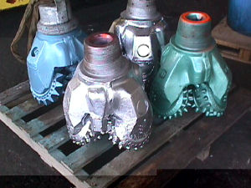
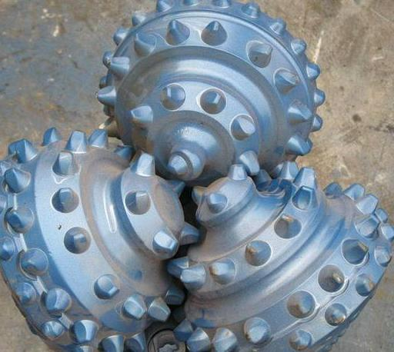
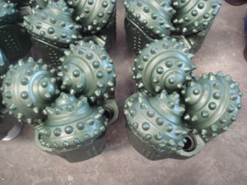
Figures(TCI)

Slide 16
PDC:-
In 1976, the cutting structure of the polycrystalline diamond compact (PDC) has made the drag bit competitive with the conventional roller cone and diamond bits.
Layer of synthetic polycrystalline diamond bonded to a layer of cemented tungsten carbide using a high-temperature, high-pressure bonding technique. The resulting blank has the hardness and wear resistance of diamond which is complemented by the strength and impact resistance of tungsten carbide.

Slide 17
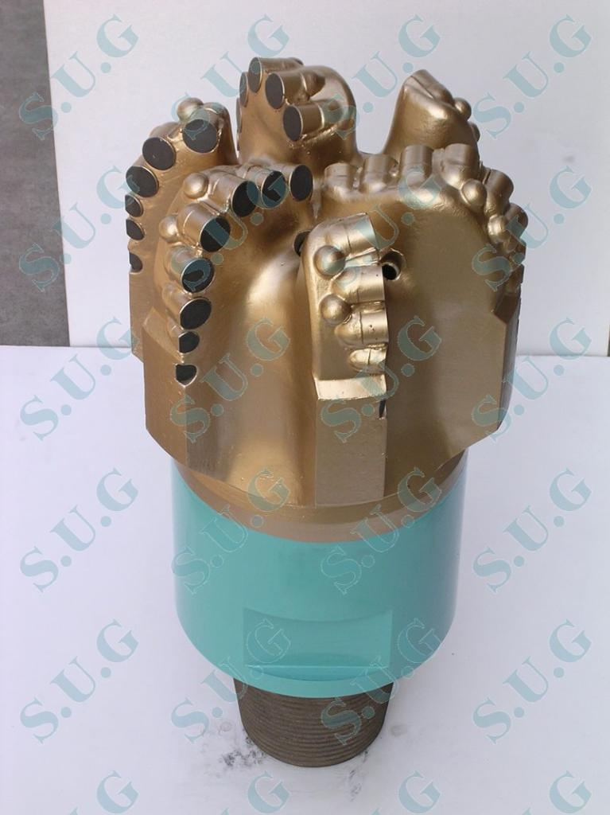
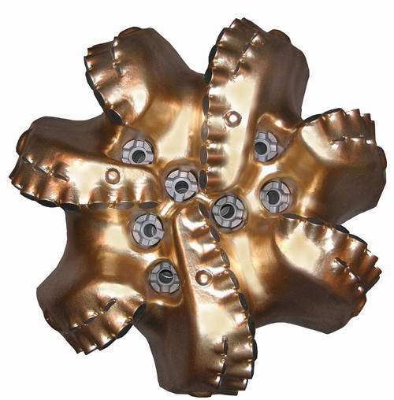
Figures(PDC)

Slide 18
SELECTION
TYPE OF FORMATION:-
SOFT MEDIUM HARD
COST OF BIT(If drilled footage is more than cost may optimized by usage of less bits).
Rather than this, the charts provided by SPE and IADC are used in bit selection criteria. Reed, Security DBS, Smith, Varel, Hughes Christine are major manufacturers of drilling bits.

Slide 19
Bit Selection in Reference of IADC
The IADC has developed a system of comparison charts for classifying drill-bits according to their design characteristics and therefore their application.
Two systems are developed for bit selection:-
1) ROLLER CONE BITS: The IADC charts for roller cone bits uses three Numbers and one Character. The sequence of numeric characters defines the “ Series, Types and Features “ of the bit. The additional character defines additional design features.
Digit 1 ( series) : The series is parted in two types:
Series 1-3 : milled tooth bits
Series 4-8 : insert bits
.

Slide 20
Digit( Type ) : Each Series is sub divided in 4 types to drillability of formation. This series and type shows increasing drillability with increasing order from 1 to 4.
Digit -3 ( Bearing /Gage ) : Seven categories of bearing design and gage protection.
1- standard roller bearing
2- roller bearing, air-cooled
3- roller bearing, gage-protected
4- sealed roller bearing
5- sealed roller bearing, gage-protected
6- sealed friction bearing
7- sealed friction bearing, gage-protected

Slide 21
4. Additional letter :
A- air application L- lug pads
B- special bearing seal M- motor application
C- center jet S- steel tooth model
D- deviation control T- two cone bit
E- extended jets W- enhanced cutting
G- gauge/body protection X- chisel tooth insert
H- horizontal application Y- conical tooth inserts
J- jet deflection Z- other shape insert

Slide 22
For example- If a bit is classified as 1-2-4-E this means that is a soft formation, milled tooth bit with sealed roller bearings and extended nozzles.
2) FIXED CUTTER BITS : This charting system also uses four characters
First char. – the first character becomes M for matrix or S for steel body construction respectively.
Second char. – It labels density and ranges from 1-4 for PDC bits, and 6-8 for surface set bits using diamond type cutter. Numbers 0, 5, 9 are reserved for future use.

Slide 23
Third char. - here digits 1-4 represents, The size of PDC cutter on this type of bit and the diamond type of surface set bits.
Fourth char. – digits 1-4 gives idea of basic appearance of bit, based on overall length of cutting face of the bit.
For example – S423 is a steel body PDC bit with a cutters density of 50 cutters or more and size ( 14-24 mm) and profile is medium.

Slide 24
DIFFERENT SIZE OF DRILLING BITS
33/4 6 77/8 97/8 143/4
37/8 61/8 83/8 105/8 171/2
41/8 61/4 81/2 11 20
43/8 61/2 83/4 121/4 24
57/8 63/4 91/2 131/2 26
133/4

Slide 25
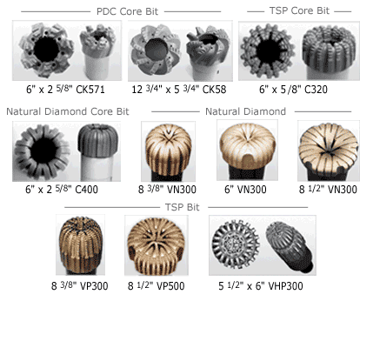
FIGURES

Slide 26
THE END
THANK
YOU

