Slide 1

ARTIFICIAL LIFT METHODS
Submitted to:- Submitted by :-
Er. Akash Rana Harrin Joe Verghese
HOD Vivek Vincent(IIIrd Year)
BHAGWANT UNIVERSITY, AJMER
Department of Petroleum Engineering

Slide 2
Artificial Lift
Artificial lift is a means of overcoming bottomhole pressure so that a well can produce at some desired rate, either by injecting gas into the producing fluid column to reduce its hydrostatic pressure, or using a downhole pump to provide additional lift pressure downhole.

Slide 3
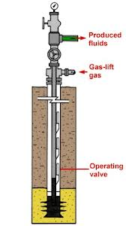
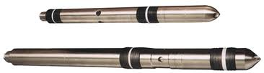
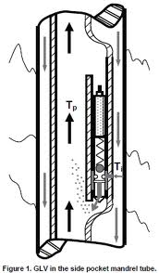
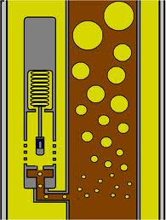
Introduction to Artificial Lift
.
Gas lift involves injecting high-pressure gas from the surface into the producing fluid column through one or more subsurface valves set at predetermined depths

Slide 4
Gas Lift
There are two main types of gas lift:
Continuous gas lift, where gas is injected in a constant, uninterrupted stream. This lowers the overall density of the fluid column and reduces the hydrostatic component of the flowing bottomhole pressure. This method is generally applied to wells with high productivity indexes.
Intermittent gas lift, which is designed for lower-productivity wells. In this type of gas lift installation, a volume of formation fluid accumulates inside the production tubing. A high-pressure “slug” of gas is then injected below the liquid, physically displacing it to the surface. As soon as the fluid is produced, gas injection is interrupted, and the cycle of liquid accumulation-gas injection-liquid production is repeated.

Slide 5
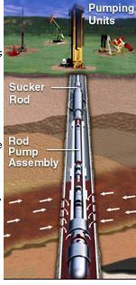
Pump-Assisted Lift – Reciprocating Rod Pump
.
Beam pumping is the most common artificial lift method. It can be used for a wide range of production rates and operating conditions, and rod pump systems are relatively simple to operate and maintain. However, the volumetric efficiency (capacity) of a rod pump is low. its initial installation may involve relatively high capital costs. Its application is very limited for deep, inclined and horizontal wells.

Slide 6
Pump-Assisted Lift – Hydraulic Pump
.
Hydraulic pump systems use a power fluid—usually light oil or water—that is injected from the surface to operate a downhole pump. Multiple wells can be produced using a single surface power fluid installation

Slide 7
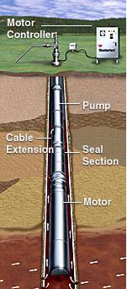
Pump-Assisted Lift – ESP
.
An electric submersible pumping (ESP) assembly consists of a downhole centrifugal pump driven by a submersible electric motor, which is connected to a power source at the surface

Slide 8
Pump-Assisted Lift – ESP
Advantages:
The most efficient lift methods on a cost-per-barrel basis.
High rate: 100 to 60,000 B/D, including high water-cut fluids.
Work in high-temperature wells (above 350°F) using high-temperature motors and cables.
The pumps can be modified to lift corrosive fluids and sand.
ESP systems can be used in high-angle and horizontal wells if placed in straight or vertical sections of the well.

Slide 9
Selecting an Artificial Lift Method – Reservoir Characteristics
Gas-liquid ratio: A high GLR generally lowers the efficiency of pump-assisted lift
Viscosity: Viscosities less than 10 cp are generally not a factor in selecting a lift method; high-viscosity fluids can cause difficulty, particularly in sucker rod pumping
Formation volume factor: Ratio of reservoir volume to surface volume determines how much total fluid must be lifted to achieve the desired surface production rate
Reservoir drive mechanism: Depletion drive reservoirs: Late-stage production may require pumping to produce low fluid volumes or injected water.
Water drive reservoirs : High water cuts may cause problems for lifting systems
Gas cap drive reservoirs : Increasing gas-liquid ratios may affect lift efficiency.

Slide 10
Selecting an Artificial Lift Method – Hole Characteristics
Well depth: The well depth dictates how much surface energy is needed to move fluids to surface, and may place limits on sucker rods and other equipment.
Completion type: Completion and perforation skin factors affect inflow performance.
Casing and tubing sizes: Small-diameter casing limits the production tubing size and constrains multiple options. Small-diameter tubing will limit production rates, but larger tubing may allow excessive fluid fallback.
Wellbore deviation: Highly deviated wells may limit applications of beam pumping or PCP systems because of drag, compressive forces and potential for rod and tubing wear.

Slide 11
Selecting an Artificial Lift Method – Surface Characteristics
Flow rates: Flow rates are governed by wellhead pressures and backpressures in surface production equipment (i.e., separators, chokes and flowlines).
Fluid contaminants: Paraffin or salt can increase the backpressure on a well.
Power sources: The availability of electricity or natural gas governs the type of artificial lift selected. Diesel, propane or other sources may also be considered.
Field location: In offshore fields, the availability of platform space and placement of directional wells are primary considerations. In onshore fields, such factors as noise limits, safety, environmental, pollution concerns, surface access and well spacing must be considered.

Slide 12
THANK YOU
.

